Slide 1
Prepared by group 2
Graduation Project
(DEPI :: Mobile Application Track)
Bank Tracking application

Slide 2
Team Members
Alshimaa Ahmed
Hager Henidy
Meguil Reda
Mahmoud Ahmed
Youssef ELshaikh
Ahmed Radwan

Slide 3
Introduction
Project Overview: “BankNest” is a mobile application available in two versions: Android (built using native Java) and Flutter. It helps users track their bank account details, calculate interest over time, and monitor their daily financial progress.
Purpose: The goal of this app is to help users easily manage their finances, calculate interest over time, and keep track of their account's historical data in a simple and efficient way.

Slide 4
Problem and Objectives
Problem: It can be difficult for individuals to manually track the daily progress of their account balances, calculate interest over time, and know their account value on a specific date.
Objectives:
Automate daily tracking of money progress.
Enable users to calculate final interest based on a percentage and a number of years.
Provide the ability to view account balances on specific dates.

Slide 5
App Overview
Functionality:
-Users enter account information, including the initial amount, bank name, and interest percentage and number of years.
-The app tracks the progress of the user's money daily, and users can view their balance on a specific date.
-Interest is calculated over the number of years specified by the user.
. Users can retrieve and view the entire history of their account transactions.
Two Versions:
-Android version: Developed using native Java.
-Flutter version.

Slide 6
Design and Architecture
UI/UX Design:
Both the Android and Flutter versions have been designed to be user-friendly, offering clean and intuitive layouts where users can input account details and view their progress.
Data Storage:
The Android version uses SQLite to store account details, interest rates, and daily progress data.
The Flutter version uses the Hive database for its local storage, offering high performance and an easy-to-use interface for storing account data and daily progress logs.

Slide 7
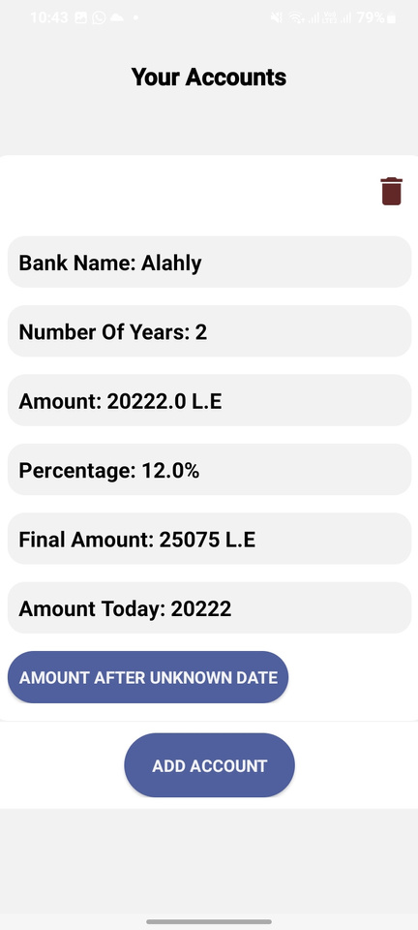
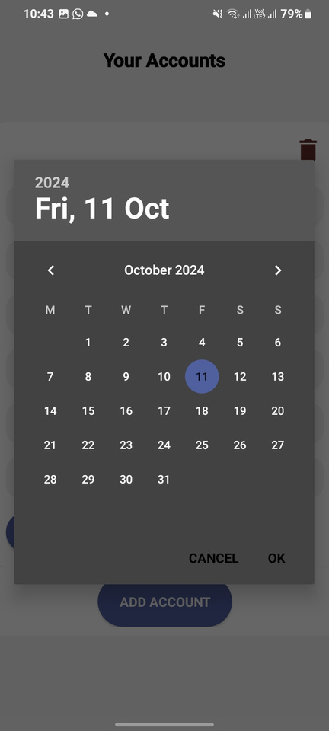
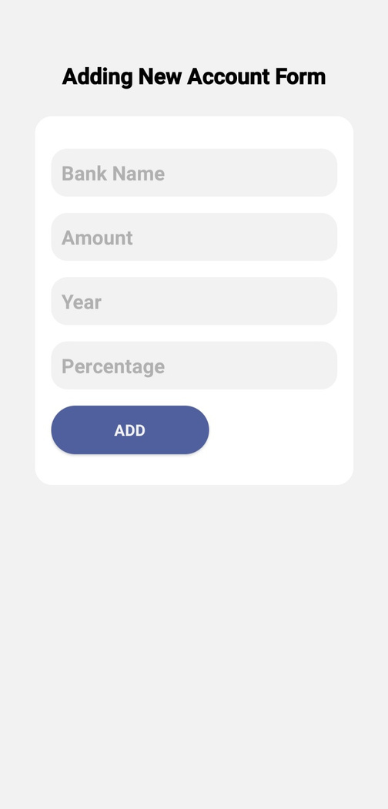
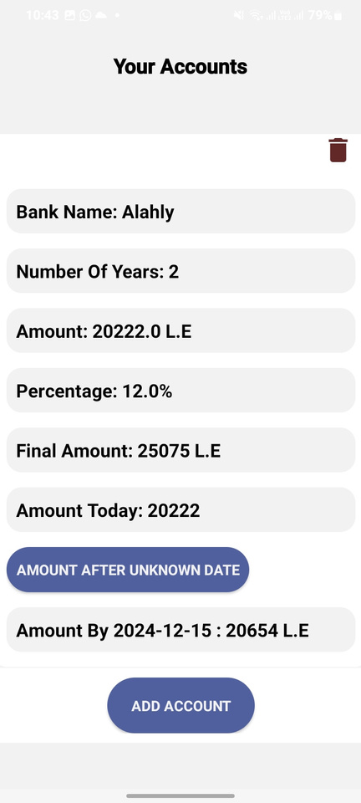
Here are screenshots of the input forms for account details, daily progress tracker, and interest calculation results

Slide 8
Key Features
Feature 1: Account Management: Users can input account details, including the amount, bank name, number of years, and interest percentage. Additionally, they can delete an account if needed.
Feature 2: Daily Money Progress: The app tracks the growth of the user’s money daily based on the interest percentage and number of years.
Feature 3: Interest Calculation: The final interest is calculated using the percentage and the number of years provided.
Feature 4: Date-based Query: Users can view their account balance on a specific date by querying the stored data for daily progress.

Slide 9
Conclusion
“BankNest” offers an efficient way for users to track daily account balances and calculate interest. With versions in both Android and Flutter, it provides a complete solution for managing bank accounts interest over time, and know their account value on a specific date.

Slide 10
Thank you

